Slide 1

CM20315 - Machine Learning
Prof. Simon Prince
7. Gradients and Initialization

Slide 2
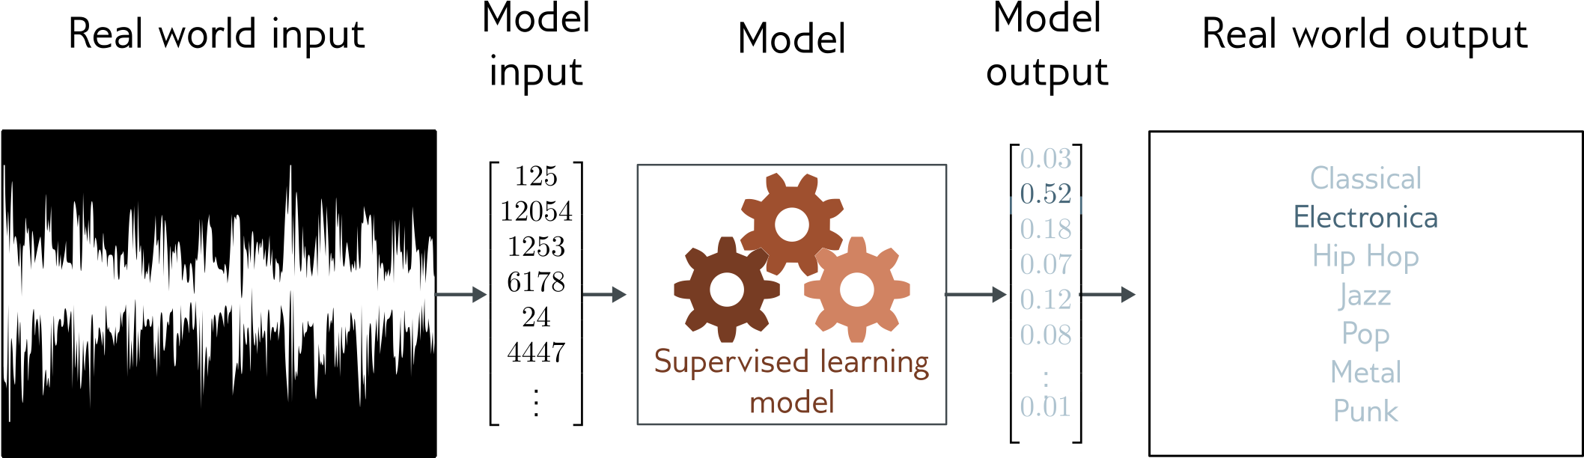
Music genre classification
Multiclass classification problem (discrete classes, >2 possible values)
Convolutional network

Slide 3
Loss function
Training dataset of I pairs of input/output examples:
Loss function or cost function measures how bad model is:
or for short:
Returns a scalar that is smaller when model maps inputs to outputs better

Slide 4
Example

Slide 5
Problem 1: Computing gradients
Loss: sum of individual terms:
SGD Algorithm:
Parameters:
Need to compute gradients

Slide 6
Why is this such a big deal?
A neural network is just an equation:
But it’s a huge equation, and we need to compute derivative
for every parameters
for every point in the batch
for every iteration of SGD

Slide 7
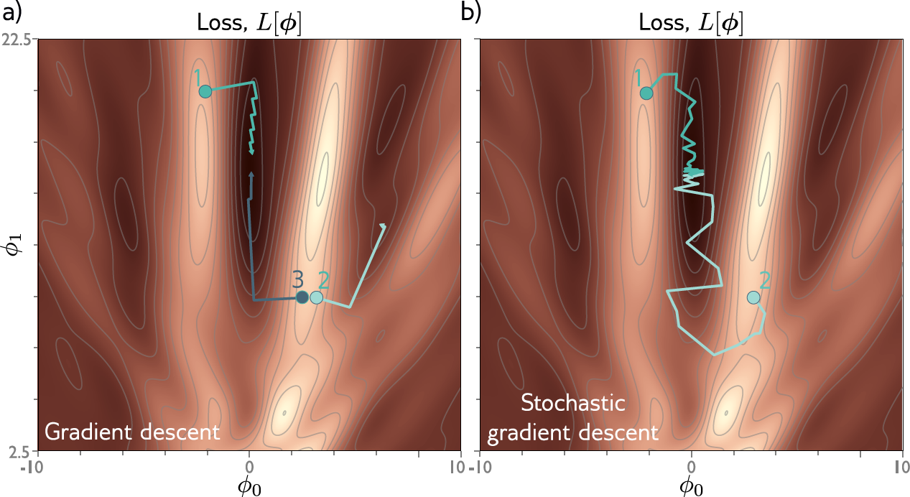
Problem 2: initialization
Where should we start the parameters before we commence SGD?

Slide 8
Gradients
Background mathematics
Backpropagation intuition
Backpropagation forward pass
Backpropagation backward pass
Algorithmic differentiation
Initialization
Code

Slide 9
Gradients of composed functions
Derivatives

Slide 10
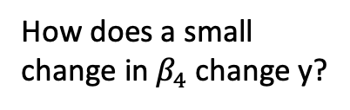
Gradients of composed functions
We want to calculate:
How does a small
change in${ β}_{4}$change y?

Slide 11
Gradients of composed functions
Calculating expressions by hand:
some expressions very complicated.
obvious redundancy (look at sin terms in bottom equation)

Slide 12
Gradients of composed functions
1. Write this as a series of
intermediate calculations
2. Compute these intermediate quantities

Slide 13
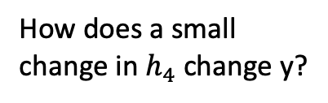
Gradients of composed functions
1. Write this as a series of
intermediate calculations
2. Compute these intermediate quantities
3. Take derivatives of output with respect to intermediate quantities
How does a small
change in${ h}_{4}$change y?

Slide 14
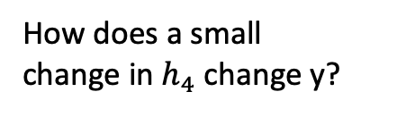
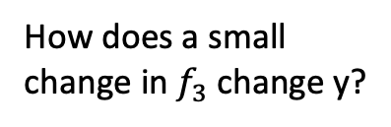
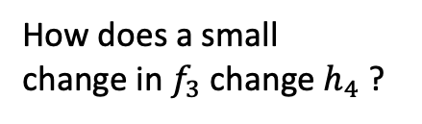
Gradients of composed functions
1. Write this as a series of
intermediate calculations
2. Compute these intermediate quantities
3. Take derivatives of output with respect to intermediate quantities
How does a small
change in${ f}_{3}$change${ h}_{4}$ ?
How does a small
change in${ h}_{4}$change y?
How does a small
change in${ f}_{3}$change y?
THE CHAIN RULE

Slide 15
Gradients of composed functions
1. Write this as a series of
intermediate calculations
2. Compute these intermediate quantities
3. Take derivatives of output with respect to intermediate quantities

Slide 16
Gradients of composed functions
1. Write this as a series of
intermediate calculations
2. Compute these intermediate quantities
3. Take derivatives of output with respect to intermediate quantities

Slide 17
Gradients of composed functions
1. Write this as a series of
intermediate calculations
2. Compute these intermediate quantities
3. Take derivatives of output with respect to intermediate quantities

Slide 18
Gradients of composed functions
1. Write this as a series of
intermediate calculations
2. Compute these intermediate quantities
3. Take derivatives of output with respect to intermediate quantities

Slide 19
Gradients of composed functions
1. Write this as a series of
intermediate calculations
2. Compute these intermediate quantities
3. Take derivatives of output with respect to intermediate quantities

Slide 20
Gradients of composed functions
1. Write this as a series of
intermediate calculations
2. Compute these intermediate quantities
3. Take derivatives of output with respect to intermediate quantities
4. Take derivatives w.r.t.
parameters

Slide 21
Gradients of composed functions
1. Write this as a series of
intermediate calculations
2. Compute these intermediate quantities
3. Take derivatives of output with respect to intermediate quantities
4. Take derivatives w.r.t.
parameters

Slide 22
Gradients of composed functions
1. Write this as a series of
intermediate calculations
2. Compute these intermediate quantities
3. Take derivatives of output with respect to intermediate quantities
4. Take derivatives w.r.t.
parameters

Slide 23
Matrix calculus
Scalar function f[] of a vector a

Slide 24
Matrix calculus
Scalar function f[] of a matrix A

Slide 25
Matrix calculus
Vector function f[] of vector a

Slide 26
Comparing vector and matrix
Scalar derivatives:

Slide 27
Comparing vector and matrix
Scalar derivatives:
Matrix derivatives:

Slide 28
Comparing vector and matrix
Scalar derivatives:
Matrix derivatives:

Slide 29
Homework: (keeners only)
Consider function:
Can write as:
Now calculate:
Write final expression as a matrix
Notes:
\frac{\partial \bff}{\partial \bfa} = \begin{bmatrix}
\frac{\partial f_{1}}{\partial a_{1}} & \frac{\partial f_{2}}{\partial a_{1}} & \frac{\partial f_{3}}{\partial a_{1}}\\
\frac{\partial f_{1}}{\partial a_{2}} & \frac{\partial f_{2}}{\partial a_{2}} & \frac{\partial f_{3}}{\partial a_{2}}\\
\frac{\partial f_{1}}{\partial a_{3}} & \frac{\partial f_{2}}{\partial a_{3}} & \frac{\partial f_{3}}{\partial a_{3}}\\
\frac{\partial f_{1}}{\partial a_{4}} & \frac{\partial f_{2}}{\partial a_{4}} & \frac{\partial f_{4}}{\partial a_{4}}
\end{bmatrix}

Slide 30
Gradients
Background mathematics
Backpropagation intuition
Backpropagation forward pass
Backpropagation backward pass
Algorithmic differentiation
Initialization
Code

Slide 31
Problem 1: Computing gradients

Slide 32
Problem 1: Computing gradients
Loss: sum of individual terms:
SGD Algorithm:
Parameters:
Need to compute gradients

Slide 33
Algorithm to compute gradient efficiently
“Backpropation algorithm”
Rumelhart, Hinton, and Williams (1986)

Slide 34
BackProp intuition #1: the forward pass
Orange weight multiplies activation (ReLU output) in previous layer
We want to know how change in orange weight affects loss
If we double activation in previous layer, weight will have twice the effect
Conclusion: we need to know the activations at each layer.

Slide 35
BackProp intuition #2: the backward pass
To calculate how a small change in a weight or bias feeding into hidden layer h₃ modifies the loss, we need to know:
how a change in layer h₃ changes the model output f
how a change in model output changes the loss l

Slide 36
BackProp intuition #2: the backward pass
To calculate how a small change in a weight or bias feeding into hidden layer h₂ modifies the loss, we need to know:
how a change in layer h₂ affects h₃
how h₃ changes the model output
how this output changes the loss

Slide 37
BackProp intuition #2: the backward pass
To calculate how a small change in a weight or bias feeding into hidden layer h₁ modifies the loss, we need to know:
how a change in layer h₁ affects layer h₂
how a change in layer h₂ affects layer h₃
how layer h₃ changes the model output
how the model output changes the loss

Slide 38
Gradients
Background mathematics
Backpropagation intuition
Backpropagation forward pass
Backpropagation backward pass
Algorithmic differentiation
Initialization
Code

Slide 39
The forward pass
1. Write this as a series of
intermediate calculations

Slide 40
The forward pass
1. Write this as a series of
intermediate calculations
2. Compute these intermediate quantities

Slide 41
Gradients
Background mathematics
Backpropagation intuition
Backpropagation forward pass
Backpropagation backward pass
Algorithmic differentiation
Initialization
Code

Slide 42
The backward pass
1. Write this as a series of
intermediate calculations
2. Compute these intermediate quantities
3. Take derivatives of output with respect to intermediate quantities

Slide 43
The backward pass
1. Write this as a series of
intermediate calculations
2. Compute these intermediate quantities
3. Take derivatives of output with respect to intermediate quantities

Slide 44
Yikes!
But:
Quite similar to:

Slide 45
The backward pass
1. Write this as a series of
intermediate calculations
2. Compute these intermediate quantities
3. Take derivatives of output with respect to intermediate quantities

Slide 46
The backward pass
1. Write this as a series of
intermediate calculations
2. Compute these intermediate quantities
3. Take derivatives of output with respect to intermediate quantities

Slide 47
Derivative of ReLU
“Indicator function”

Slide 48
Derivative of RELU
where:
1. Consider:
2. We could equivalently write:
3. Taking the derivative
4. We can equivalently pointwise multiply by diagonal

Slide 49
The backward pass
1. Write this as a series of
intermediate calculations
2. Compute these intermediate quantities
3. Take derivatives of output with respect to intermediate quantities

Slide 50
The backward pass
1. Write this as a series of
intermediate calculations
2. Compute these intermediate quantities
3. Take derivatives of output with respect to intermediate quantities
4. Take derivatives w.r.t.
parameters

Slide 51
The backward pass
1. Write this as a series of
intermediate calculations
2. Compute these intermediate quantities
3. Take derivatives of output with respect to intermediate quantities
4. Take derivatives w.r.t.
parameters

Slide 52
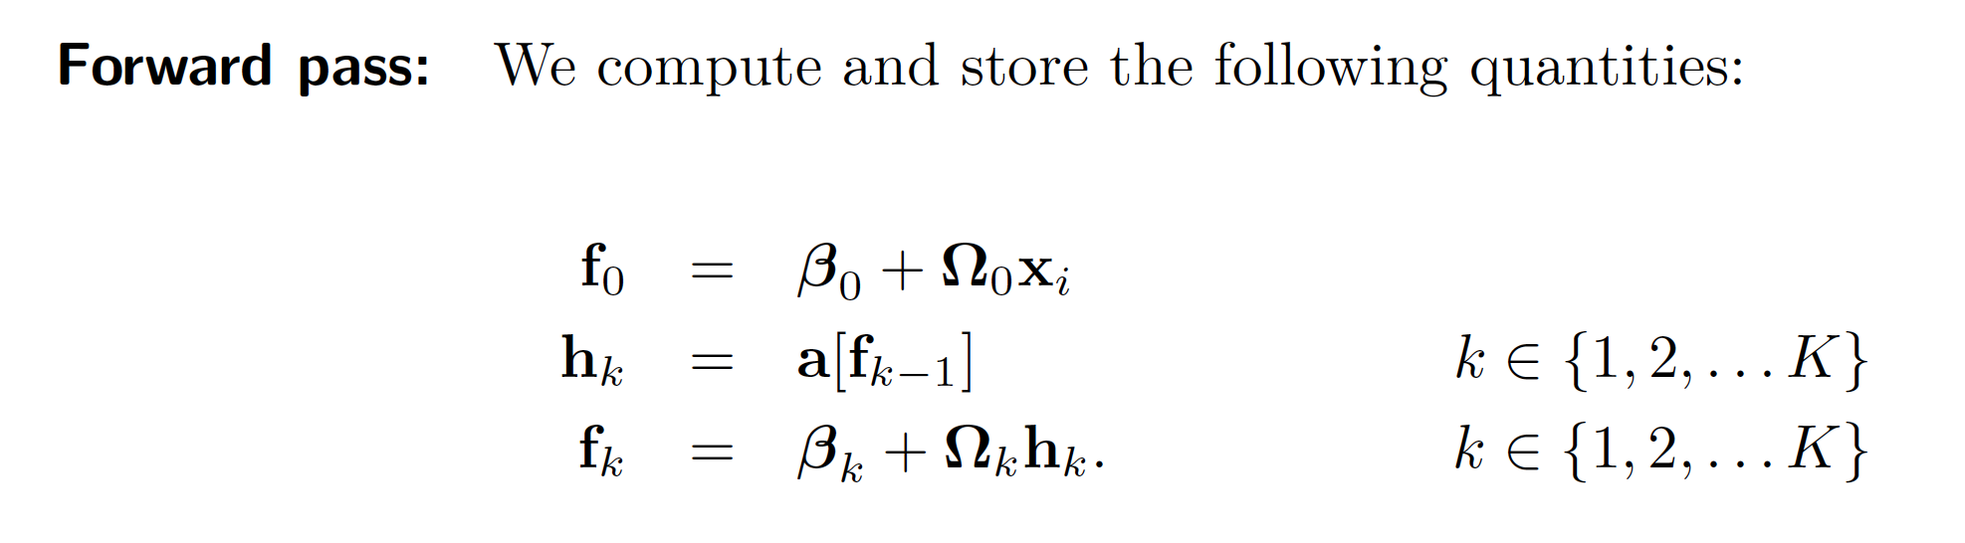
Backprop summary

Slide 53
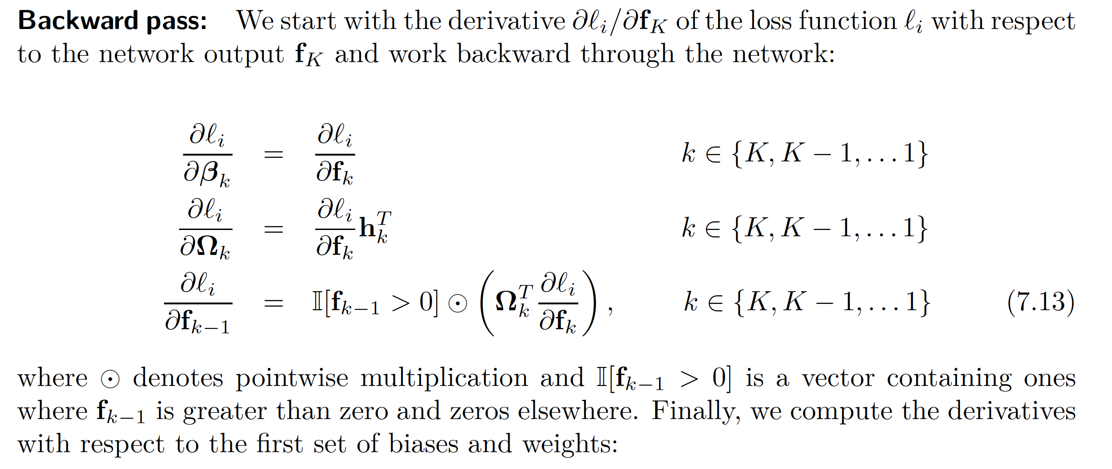
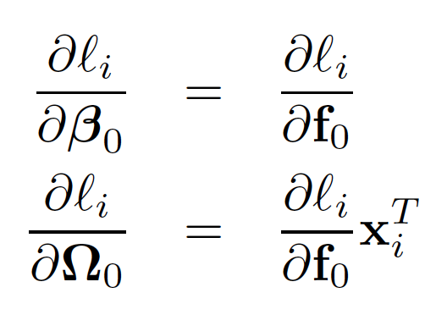
Backprop summary

Slide 54
Pros and cons
Extremely efficient
Only need matrix multiplication and thresholding for RELU functions
Memory hungry – must store all of the intermediate quantities
Sequential
can process multiple batches in parallel
but things get harder if the whole model doesn’t fit on one machine.

Slide 55
Gradients
Background mathematics
Backpropagation intuition
Backpropagation forward pass
Backpropagation backward pass
Algorithmic differentiation
Initialization
Code

Slide 56
Algorithmic differentiation
Modern deep learning frameworks compute derivatives automatically
You just have to specify the model and the loss
How? Algorithmic differentiation
Each component knows how to compute its own derivative
ReLU knows how to compute deriv of output w.r.t. input
Linear function knows how to compute deriv of output w.r.t. input
Linear function knows how to compute deriv of output w.r.t. parameter
You specify how the order of the components
It can compute the chain of derivatives

Slide 57
Gradients
Background mathematics
Backpropagation intuition
Backpropagation forward pass
Backpropagation backward pass
Algorithmic differentiation
Initialization
Code

Slide 58
Initialization
Consider standard building block of NN:
How do we initialize the biases and weights?
Equivalent to choosing starting point in Gabor/Linear regression models

Slide 59
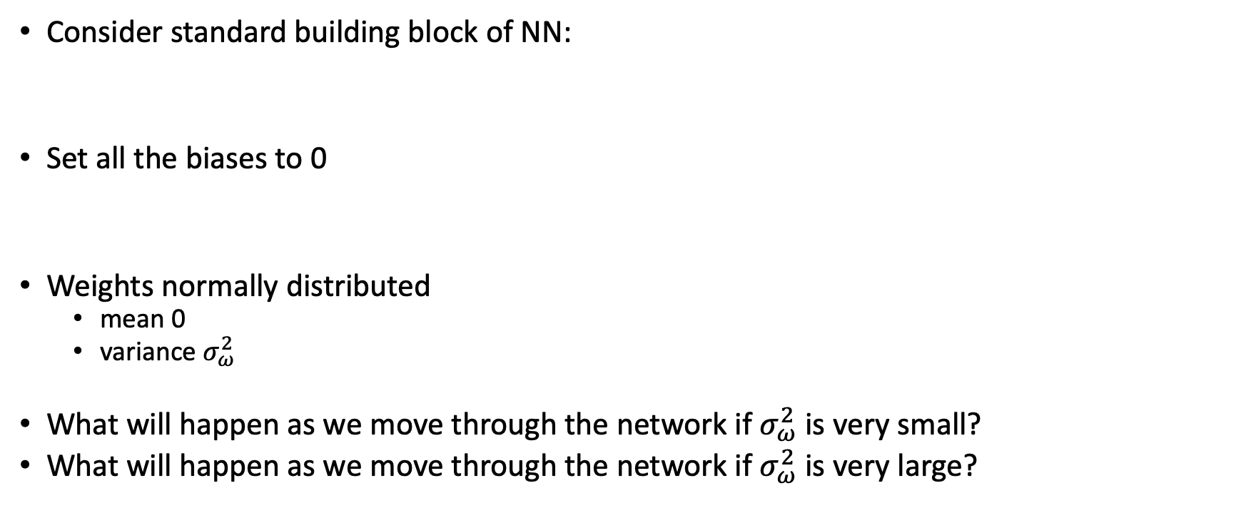
Initialization
Consider standard building block of NN:
Set all the biases to 0
Weights normally distributed
mean 0
variance${{ σ}_{ω}^{2}}_{ }$
What will happen as we move through the network if${ σ}_{ω}^{2}$ is very small?
What will happen as we move through the network if $σ_{ω}^{2}$ is very large?

Slide 60
Backprop summary

Slide 61
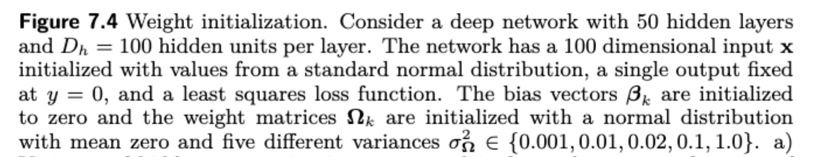
Exploding gradients
Vanishing gradients

Slide 62
He initialization (assumes ReLU)
Forward pass: want the variance of hidden unit activations in layer k+1 to be the same as variance of activations in layer k:
Backward pass: want the variance of gradients at layer k to be the same as variance of gradient in layer k+1:
Number of units at layer k
Number of units at layer k+1

Slide 63
Exploding gradients
Vanishing gradients

Slide 64
Expectation
Interpretation: what is the average value of g[x] when taking into account the probability of x?
Could approximate, by sampling many values of x from the distribution, calculating g[x], and taking average.

Slide 65
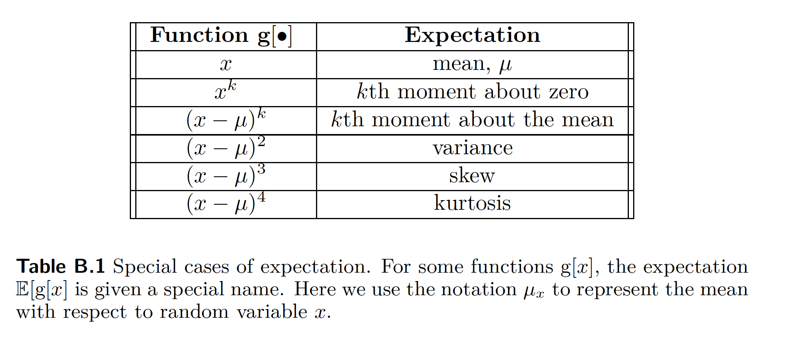
Expectations

Slide 66
Rules for manipulating expectation

Slide 67
Rule 1

Slide 68
Rules for manipulating expectation

Slide 69
Rule 2

Slide 70
Rules for manipulating expectation

Slide 71
Rule 3

Slide 72
Rules for manipulating expectation

Slide 73
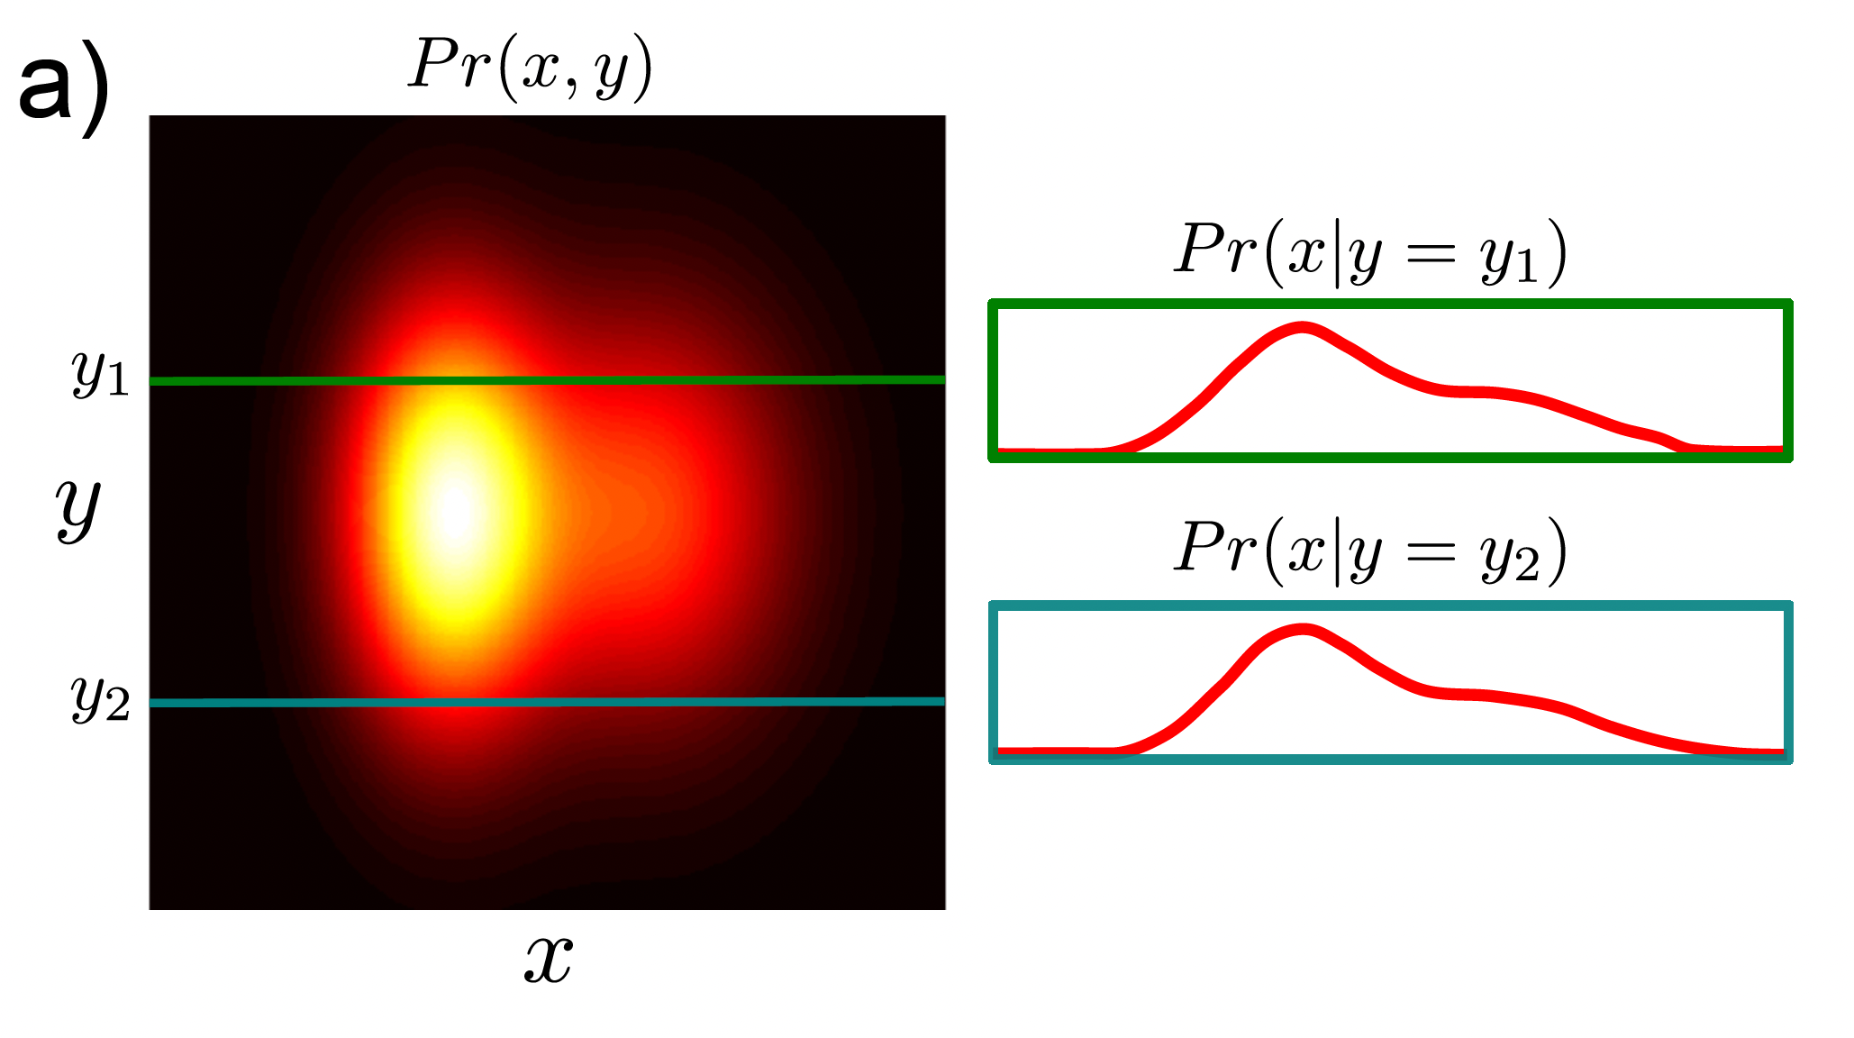
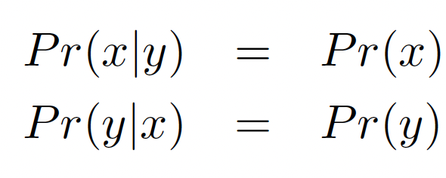
Independence
Probability of x and y

Slide 74
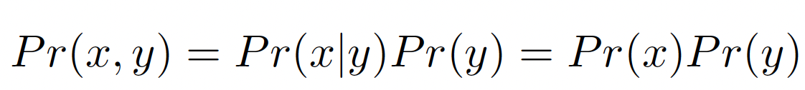
Independence
Probability of x and y

Slide 75
Rule 4
Because independent

Slide 76
Now you prove:
Keeping in mind:

Slide 77
Now you prove:
Keeping in mind:

Slide 78
Rule 1:
Rule 2:
Rule 3:
Def’n

Slide 79
Rule 1:
Rule 2:
Rule 3:
Def’n

Slide 80
Rule 1:
Rule 2:
Rule 3:
Def’n

Slide 81
Rule 1:
Rule 2:
Rule 3:
Def’n

Slide 82
Rule 1:
Rule 2:
Rule 3:
Def’n

Slide 83
Rule 1:
Rule 2:
Rule 3:
Def’n

Slide 84
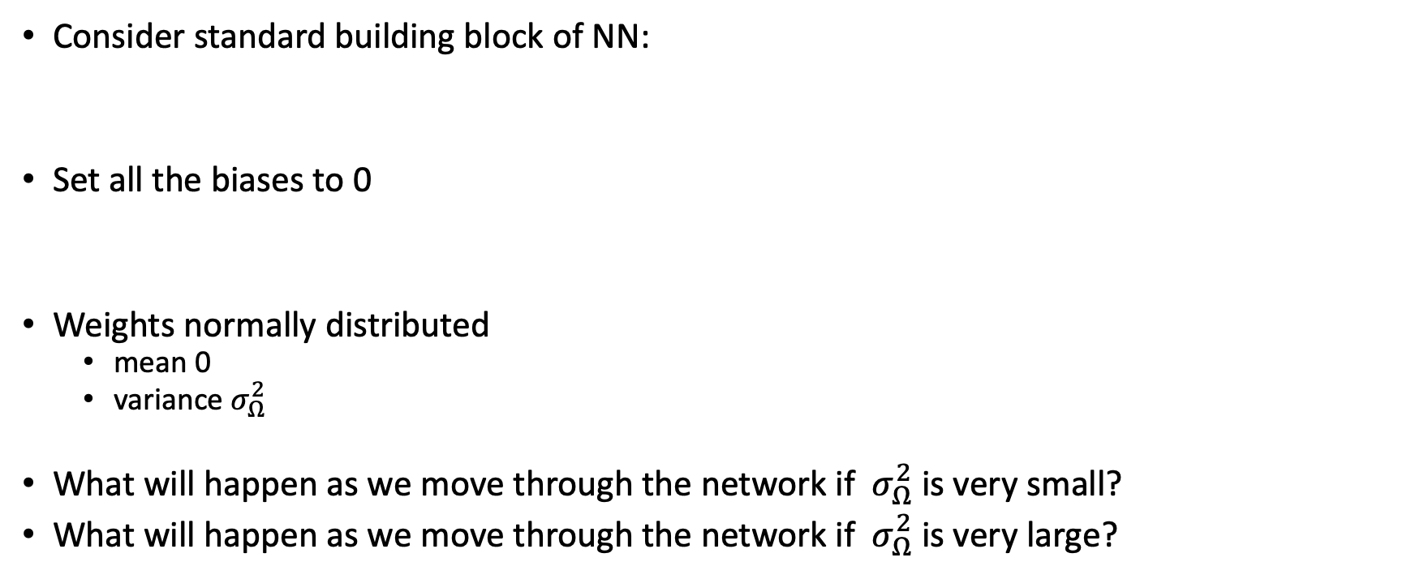
Initialization
Consider standard building block of NN:
Set all the biases to 0
Weights normally distributed
mean 0
variance${{ σ}_{Ω}^{2}}_{ }$
What will happen as we move through the network if ${ σ}_{Ω}^{2}$is very small?
What will happen as we move through the network if ${ σ}_{Ω}^{2}$is very large?

Slide 85
Aim: keep variance same between two layers

Slide 86
Rule 1:
Rule 2:
Rule 3:
Rule 4:

Slide 87
Rule 1:
Rule 2:
Rule 3:
Rule 4:

Slide 88
Rule 1:
Rule 2:
Rule 3:
Rule 4:

Slide 89
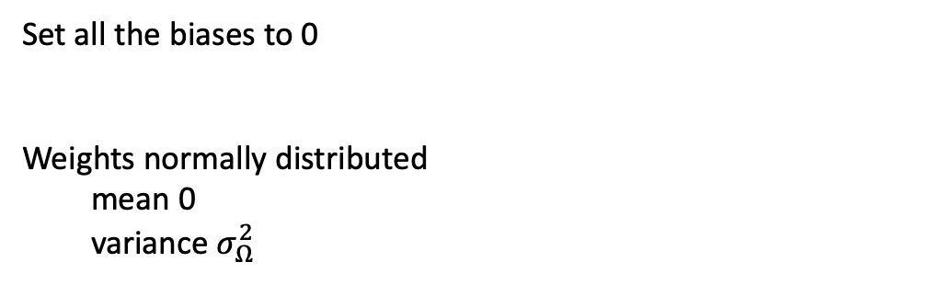
Rule 1:
Rule 2:
Rule 3:
Rule 4:
Set all the biases to 0
Weights normally distributed
mean 0
variance${{ σ}_{Ω}^{2}}_{ }$

Slide 90
Aim: keep variance same between two layers

Slide 91
Aim: keep variance same between two layers

Slide 92
Rule 1:
Rule 2:
Rule 3:
Rule 4:
Set all the biases to 0
Weights normally distributed
mean 0
variance${{ σ}_{Ω}^{2}}_{ }$

Slide 93
Rule 1:
Rule 2:
Rule 3:
Rule 4:
Set all the biases to 0
Weights normally distributed
mean 0
variance${{ σ}_{Ω}^{2}}_{ }$

Slide 94
Rule 1:
Rule 2:
Rule 3:
Rule 4:
Set all the biases to 0
Weights normally distributed
mean 0
variance${{ σ}_{Ω}^{2}}_{ }$

Slide 95
Rule 1:
Rule 2:
Rule 3:
Rule 4:
Set all the biases to 0
Weights normally distributed
mean 0
variance${{ σ}_{Ω}^{2}}_{ }$

Slide 96
Rule 1:
Rule 2:
Rule 3:
Rule 4:
Set all the biases to 0
Weights normally distributed
mean 0
variance${{ σ}_{Ω}^{2}}_{ }$

Slide 97
Aim: keep variance same between two layers

Slide 98
Aim: keep variance same between two layers

Slide 99
Gradients
Background mathematics
Backpropagation intuition
Backpropagation forward pass
Backpropagation backward pass
Algorithmic differentiation
Initialization
Code

Slide 100
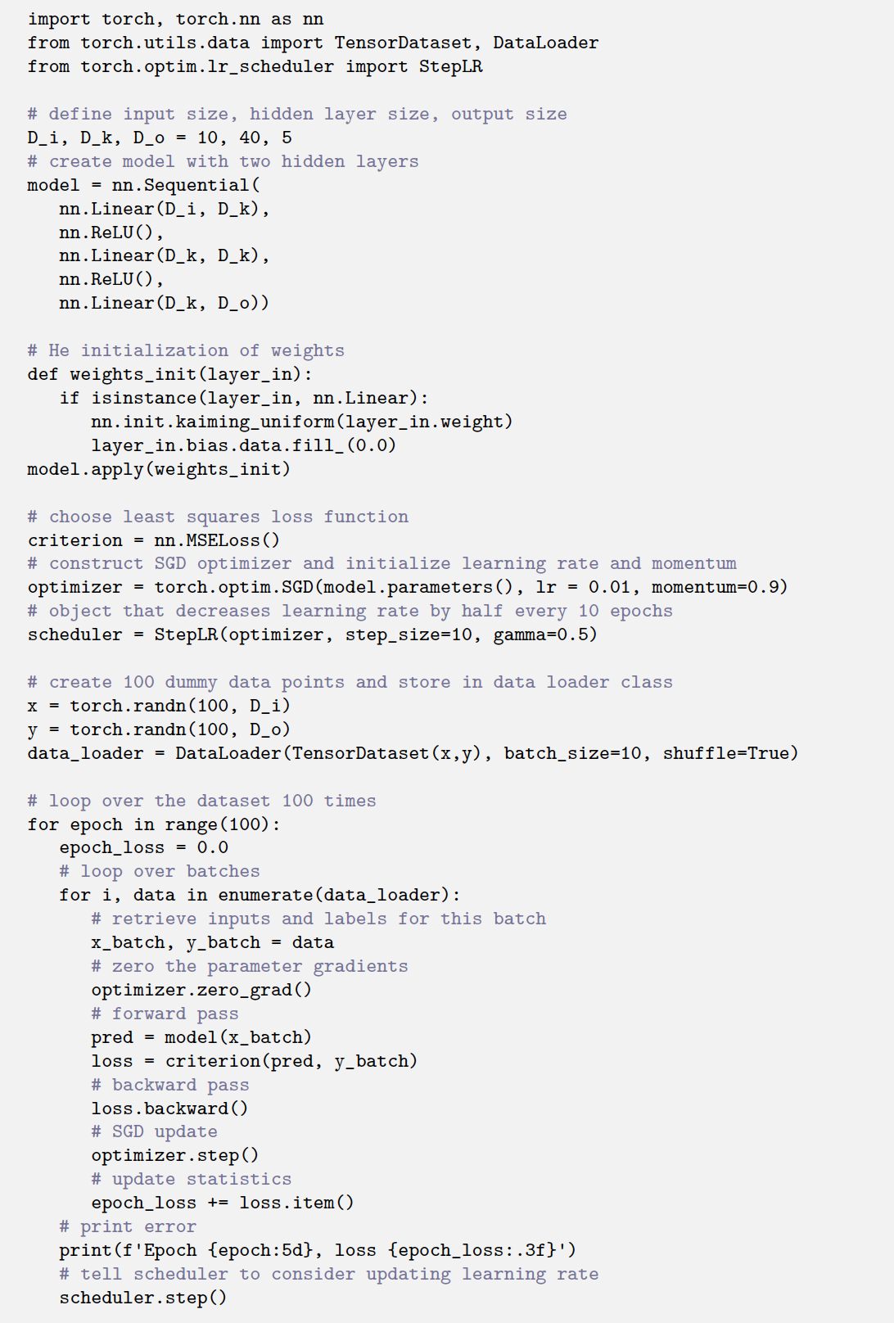
PyTorch code
Define a neural network
Initialize params with He initialization
Define loss function
Choose optimization algorithm
Choose initial learning rate
Choose learning rates schedule
Make some random data
Train for 100 batches

Slide 101
PyTorch code
Define a neural network
Initialize params with He initialization
Define loss function
Choose optimization algorithm
Choose initial learning rate
Choose learning rates schedule
Make some random data
Train for 100 batches

Slide 102
PyTorch code
Define a neural network
Initialize params with He initialization
Define loss function
Choose optimization algorithm
Choose initial learning rate
Choose learning rates schedule
Make some random data
Train for 100 batches

